Slide 1
Envisioning the frontier of work
Kickstarter workshop

Slide 2
Envisioning the frontier of work Kickstarter workshop
Welcome to the Reimagining Work workshop.
This session is designed to help you step back from tools and solutions, and instead focus on how work actually happens today — across roles, processes, and moments of innovation.
Rather than starting with technology, we start with reality:
How people spend their time
Where friction, delays, and workarounds exist
Where automation and AI could create meaningful improvement
During the workshop, you will:
Examine real roles and processes from your organization
Identify friction points that matter
Explore how AI agents could augment work, not just automate tasks
Translate ideas into clear, high-value use cases

Slide 3
Kickstarter workshops
Workshops generally follow either a presentation + lab format, or a principles-based approach. Kickstarter workshops use the principles-based method, focusing on understanding the ‘why’ through discussions – ideal for fostering strategic, adaptable insights.
Presentation + lab content
Principles-focused
Balanced learning approach
Principles-driven learning
A mix of presentation-heavy segments and hands-on labs offer conceptual understanding and practical application.
Emphasizes understanding the core principles and ‘why’ behind the processes
Collaborative and conversation heavy
Structured, step-by-step guides
Sessions center around group discussions, encouraging participants to share perspectives and explore topics deeply together.
Participants receive clear instructions for each lab task allowing them to follow along at their own pace with guided support.
Minimal lab, maximum reflection
Reinforces key concepts
The flow from theory to proactive reinforces learning, helping participants see immediate application of what they just learned.
Rather than focusing on hands-on-labs, this workshop prioritizes reflective exercises and activities that encourage participants to think critically about real-world

Slide 4
Why we are here…
The reality of work
Before redesigning processes or deploying AI agents, it helps to understand where work time actually goes. These statistics reveal a consistent pattern: knowledge workers spend far more time on coordination, repetition, and friction than on the skilled work they were hired to do. This is the opportunity space for intelligent automation.
Anatomy of a Role
Tasks
Only 26% of time goes to skilled work; 60% to coordination; 14% to strategy (Asana)
Just 4% of activities require creativity at median human level (McKinsey)
Only 29% require emotional sensing at median human level
Collaboration
50%+ of working hours spent collaborating with coworkers (Gensler)
Time on collaborative activities has increased 50%+ over two decades (HBR)
But 20-35% of value-added collaboration comes from just 3-5% of employees
Friction
88% of workers report friction in their environment (Dayforce 2025)
2 hours/day wasted trying to work around friction (Gartner)
95% say friction makes them feel bad about their job (FOUNT)
Repetition
90% of employees feel burdened with boring, recurring tasks (Clockify)
3+ hours/day on automatable tasks — that's 60 hours/month (Automation Anywhere)
60% could save 6+ hours/week if repetitive aspects were automated

Slide 5
Why we are here…
Process Patterns
How Processes Break Down
Key insight: 5 basic control-flow patterns cover virtually all moderate-complexity processes. Handoffs between people and systems are the most failure-prone points.
Automation Potential (McKinsey)
Most automatable: Data collection, data processing, routine cognitive tasks, predictable physical tasks.
Least automatable: Managing others, applying expertise/judgment, stakeholder interaction requiring empathy.
The Opportunity for AI Agents
These statistics point to a clear opportunity: AI agents can reclaim the 60%+ of time currently lost to coordination, repetition, and friction — freeing humans for the creative, strategic, and interpersonal work that only they can do.
Where Agents Add Value
Automation isn't about replacing people — it's about removing the friction, repetition, and coordination overhead that prevents them from doing their best work.
80% | of process flows are sequential (step-by-step)
15% | involve decision points (branching paths)
10% | have parallel work streams (simultaneous)
45% | of work activities automatable with current technology (2017)
57% | automatable with current tech including GenAI (2025)
30% | of activities in 60% of all occupations could be automated
Dimension | Key Statistic | Agent Opportunity
Tasks | 26% skilled, 60% coordination | Agents absorb coordination overhead
Collaboration | 50%+ time collaborating | Handle routine status, scheduling, drafting
Time | Only 4-5 hrs/day on core work | Reclaim time from communication overhead
Friction | 88% experience friction | Eliminate friction at handoffs and data-gathering
Repetition | 62% on repetitive tasks | Highest automation potential

Slide 6
What it means to
become Frontier
To become Frontier means more than adopting a few new tools — it’s a strategic transformation in how work gets done, how decisions are made, and how value is created.
A Frontier Firm is defined not by its industry or size, but by its mindset and execution:
Intelligence is embedded throughout the company, not siloed in pockets.
AI and automation are integrated into core work, not just experiments at the edge.
Humans lead with purpose and judgment, while AI handles routine and data-intensive work.
.
In a Frontier organization:
AI isn’t an add-on — it’s central to how the business operates.
Employees and AI agents work together — humans set direction, AI executes at scale.
Value is unlocked through speed, agility, and deeper insights across functions.
This evolution is not about replacing people, but amplifying human impact:
Creativity, strategy, and decision-making become the focus of human work.
Routine task work is delegated to intelligent systems.
Organizations scale more quickly and adapt more fluidly to change.

Slide 7
Workshop flow
Select
Start by choosing your entry point – will you explore a single role, an existing process or a new/reimagined experience?
Map & identify
Use the mapping tools to capture what happens today. Break the work into steps or moments and note where the flow slows down or feels painful.
Assess, prioritize & ideate
Evaluate each pain point for impact & value, brainstorm ideas and improvements, then prioritize the most promising.
Design
Take your top idea and design a solution – define what the agent does, how it interacts with humans and systems, what data it needs and how you’ll measure its success.

Slide 8
Selecting your starting lens
Instructions
Select the lens that best describes where you want to focus your improvement or innovation efforts.
Then complete the related fields to help your team frame the who, what, why, and value.
Role
augmentation
Process
optimization
Reimagined
experiences
All three paths lead to a prioritized agent concept – they just start from different perspectives.

Slide 9
Work insight canvas
1. High-level information
Starting lens selected: Role Process Experience
Name / title: ________________________________________
Owner/ lead: ________________________________________
2. Context & scope
Describe the focus area:
(What are we analyzing?)
Why is this important now?
(What strategic priority or problem does this tie to?)

Slide 10
Work insight canvas
3. Current reality
a) Who is affected?
(Check all that apply or write role name)
Individual role
Team/ group
Customer/ external user
Other: ____________________
b) What happens now (steps)?
Map the actual sequence of work.
(Write each step on its own line)
1. ____________________________________________________________________________
2. ____________________________________________________________________________
3. ____________________________________________________________________________
4. ____________________________________________________________________________
5. ____________________________________________________________________________

Slide 11
Work insight canvas
5. Tools, systems used and pain points
Tasks / steps (list or process map)
Tools/ systems used:
Highest priority pain point/ friction area:

Slide 12
Mapping

Slide 13
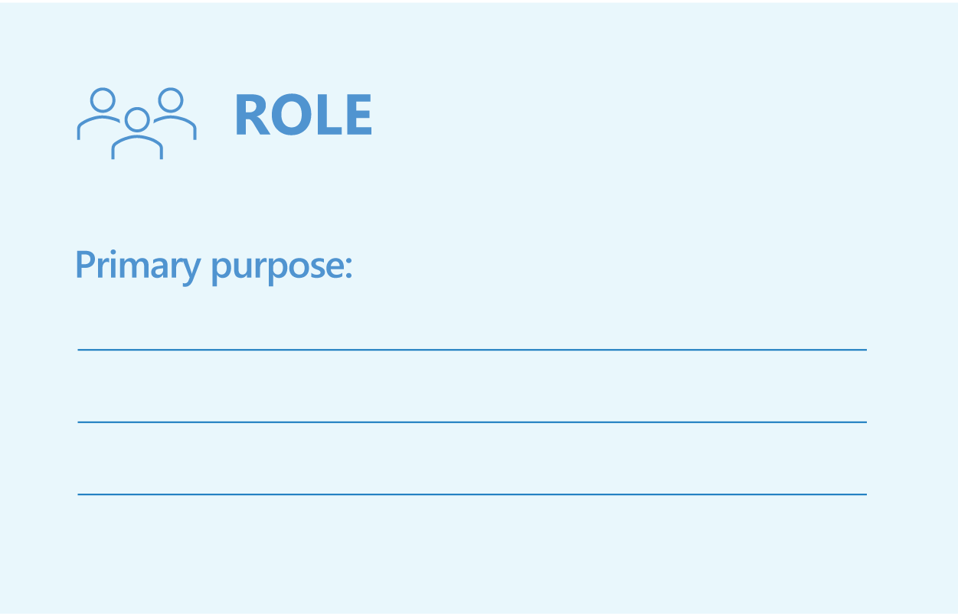
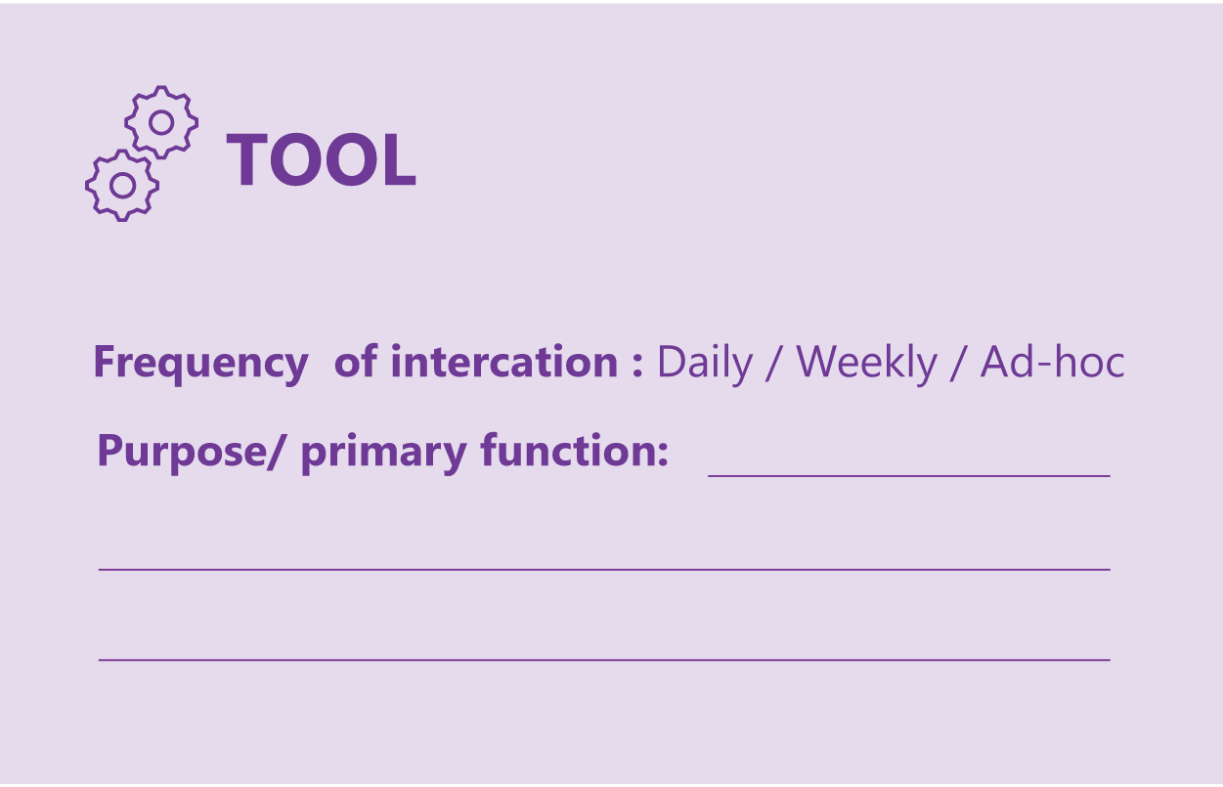
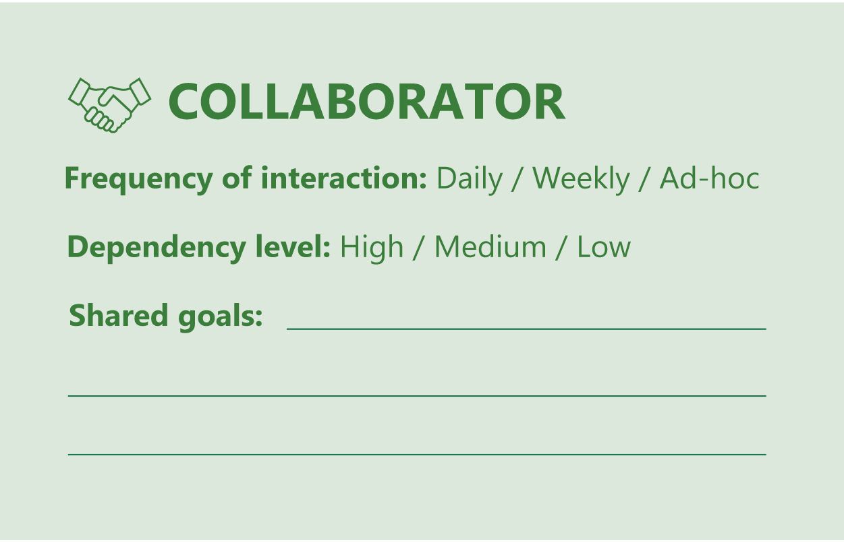
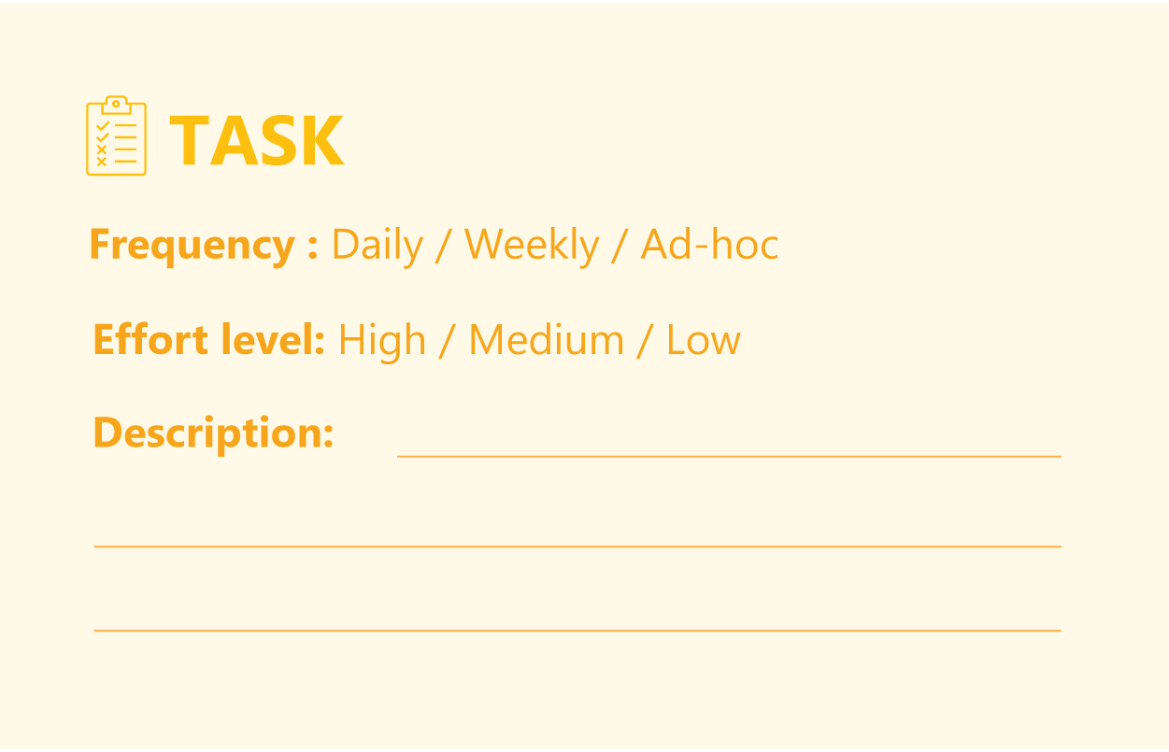
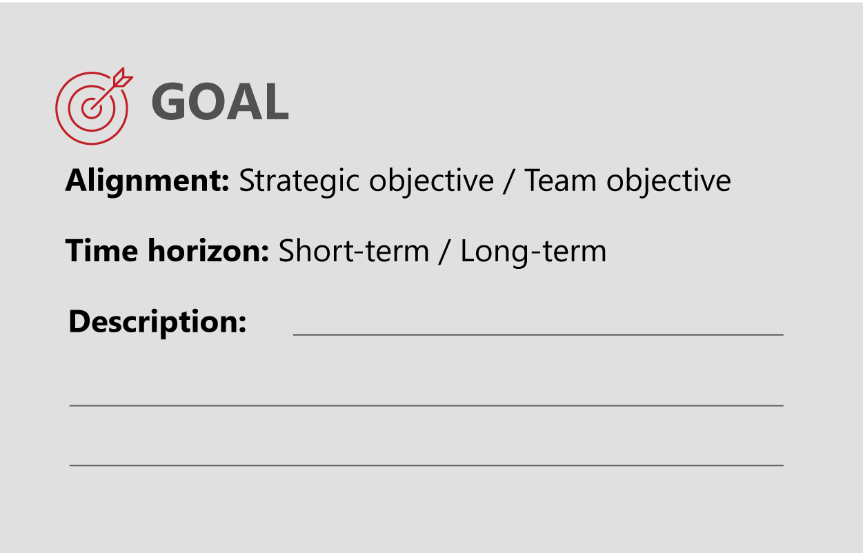
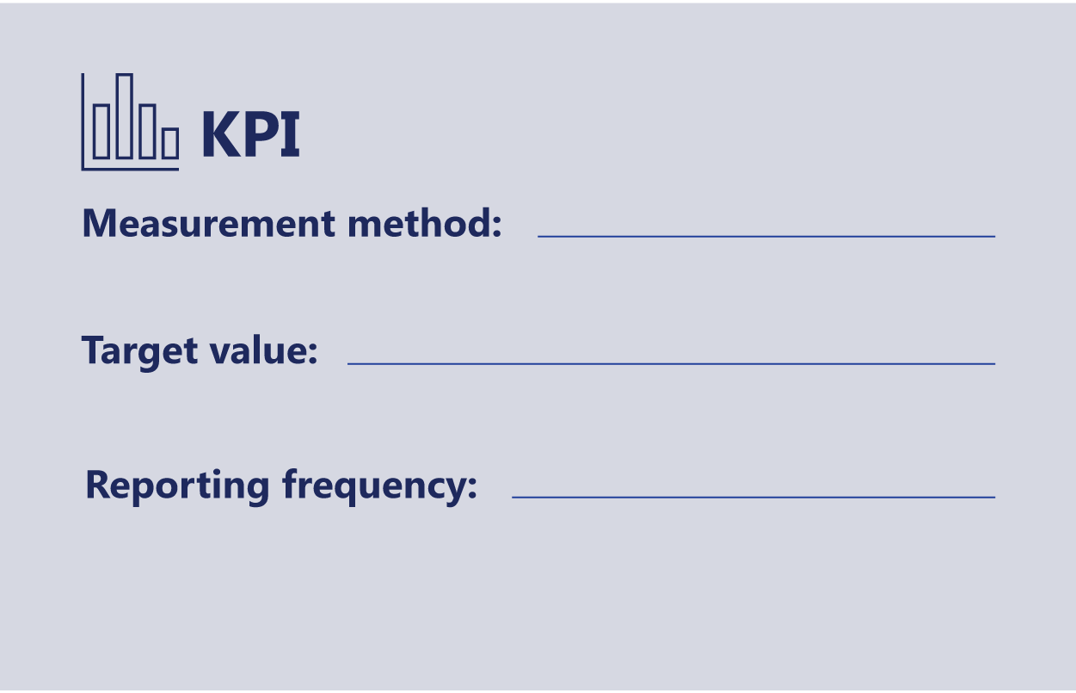
Role mapping cards
Defines who the work is for and what they are fundamentally accountable for.
Shows which systems or applications the role uses to get work done.
Identifies who the role regularly depends on, or hands work to and from.
Captures the specific pieces of work the role performs on a typical day.
Describes what success looks like for the role beyond just completing tasks.
Defines how success is measured and how often it’s reviewed.

Slide 14
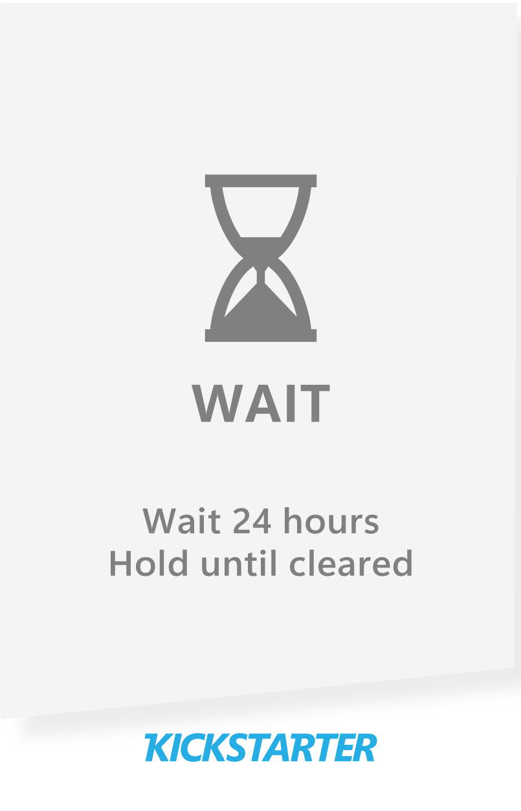
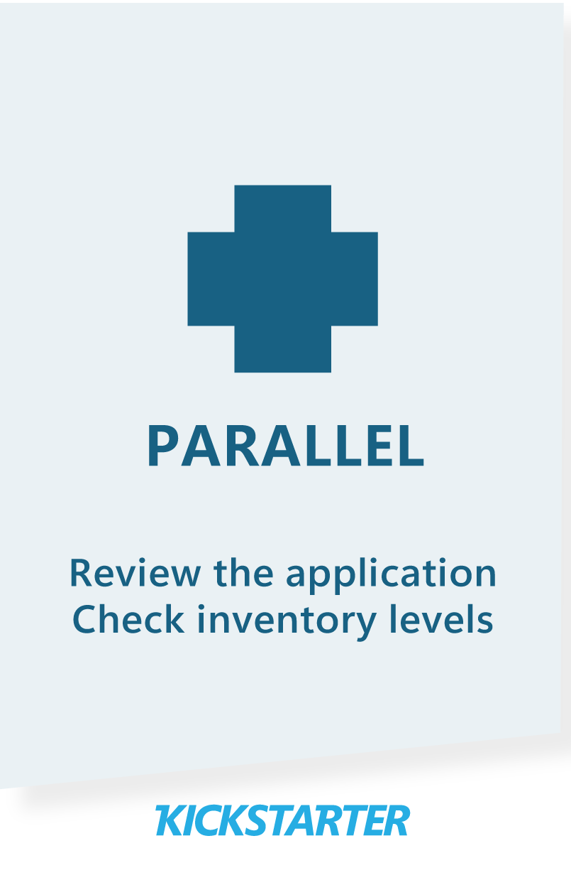
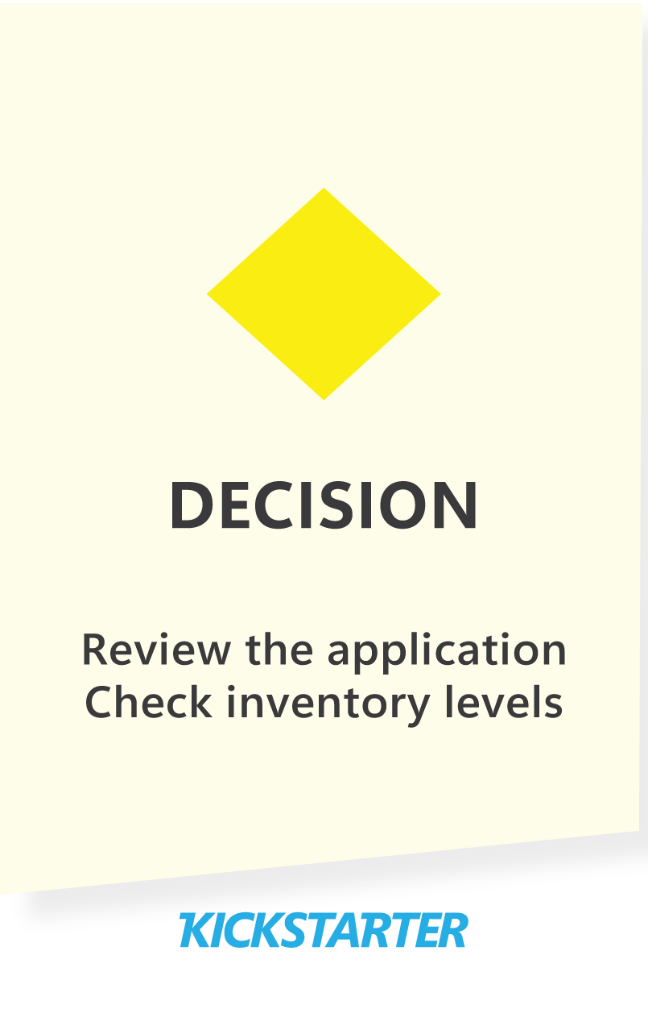
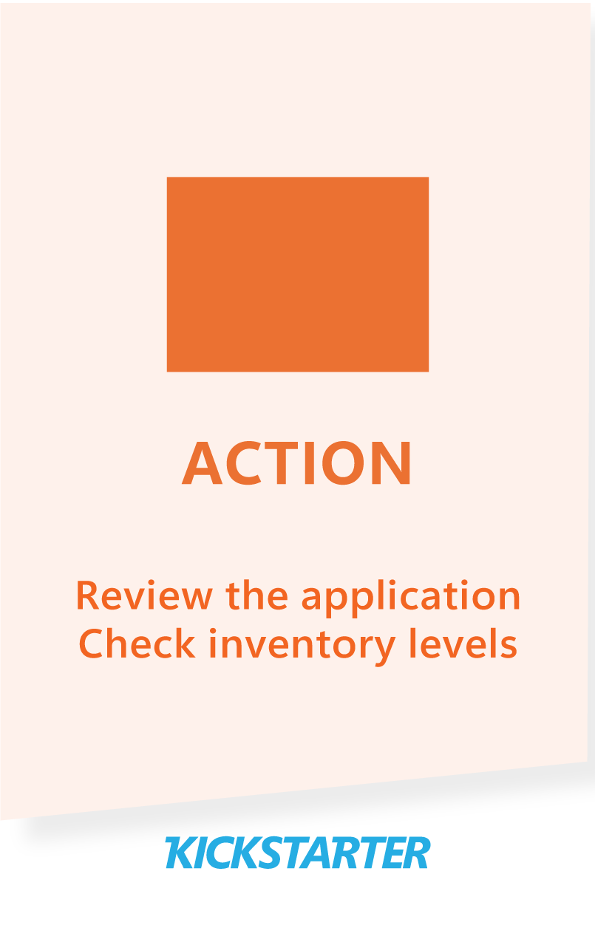
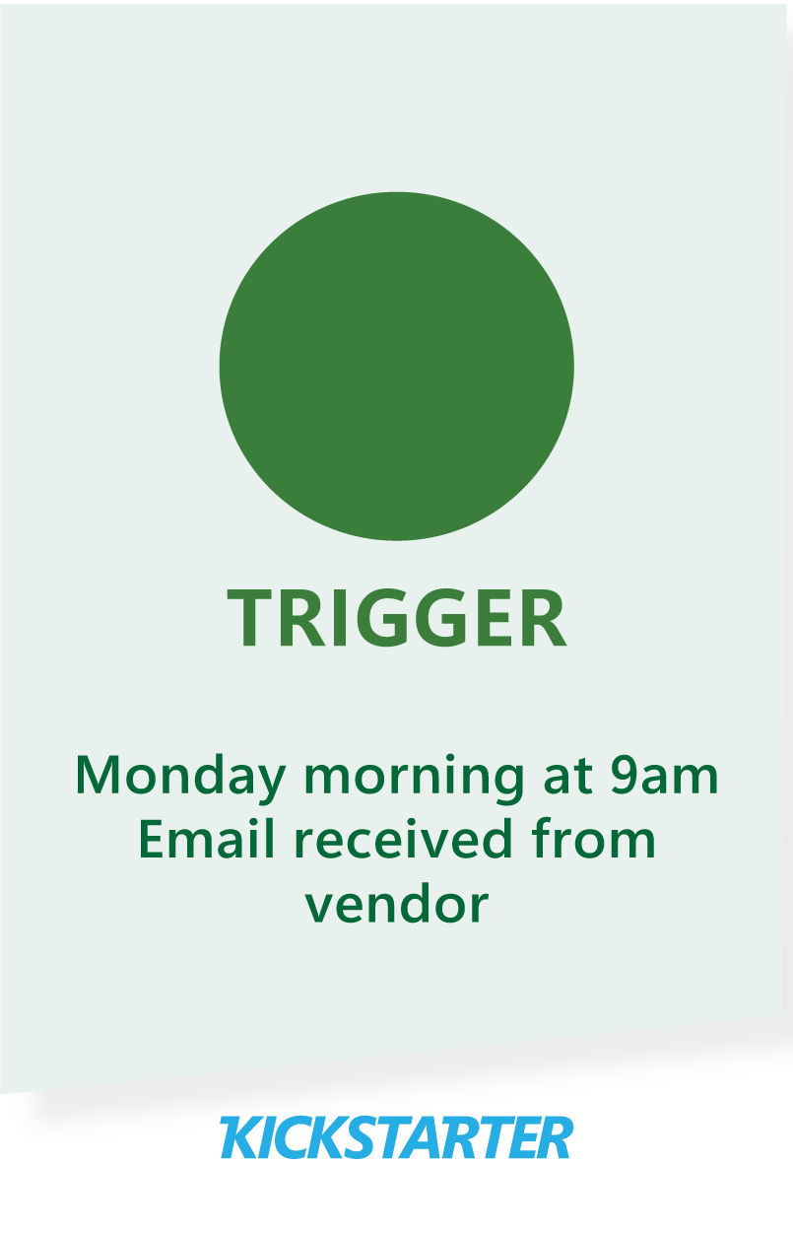
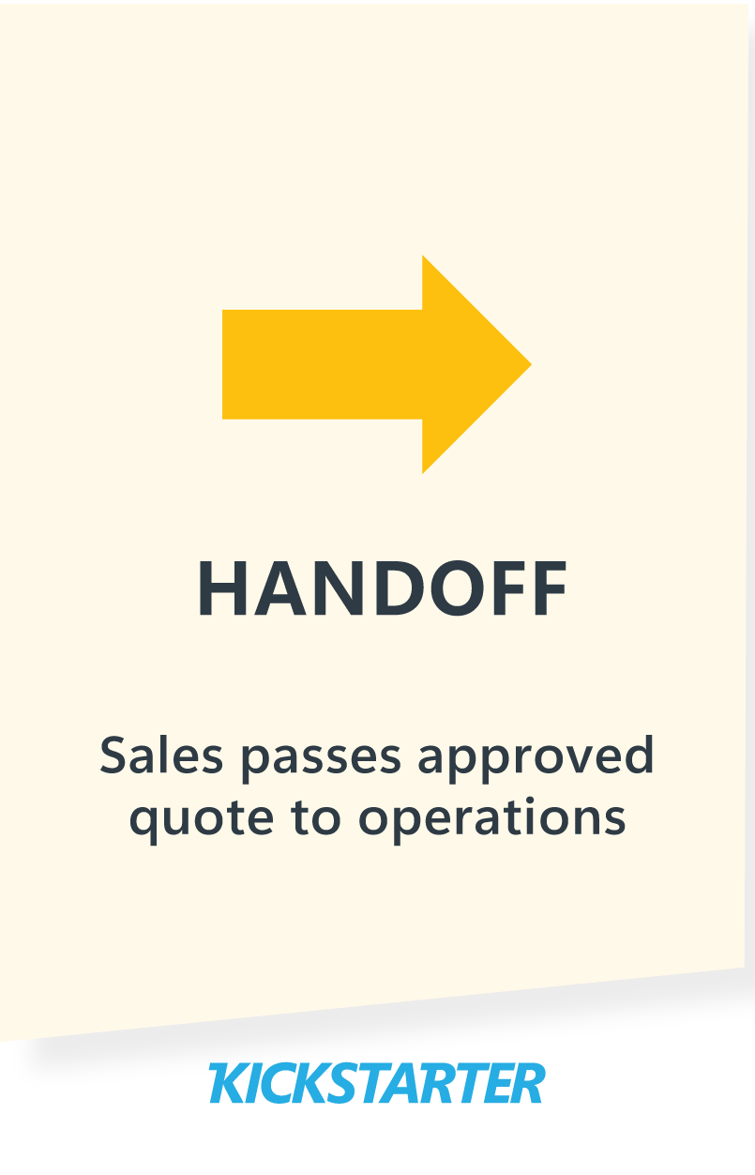
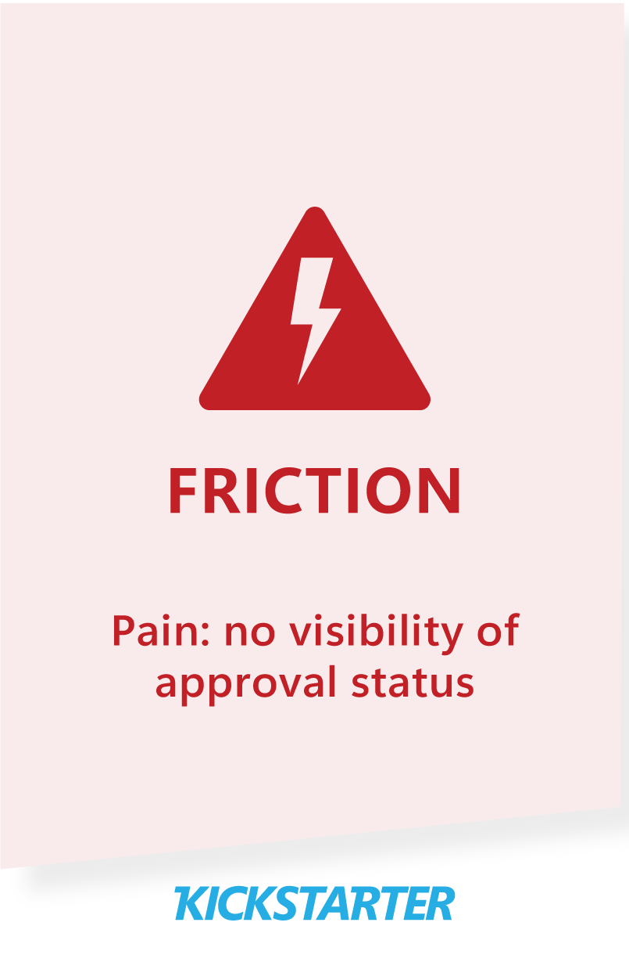
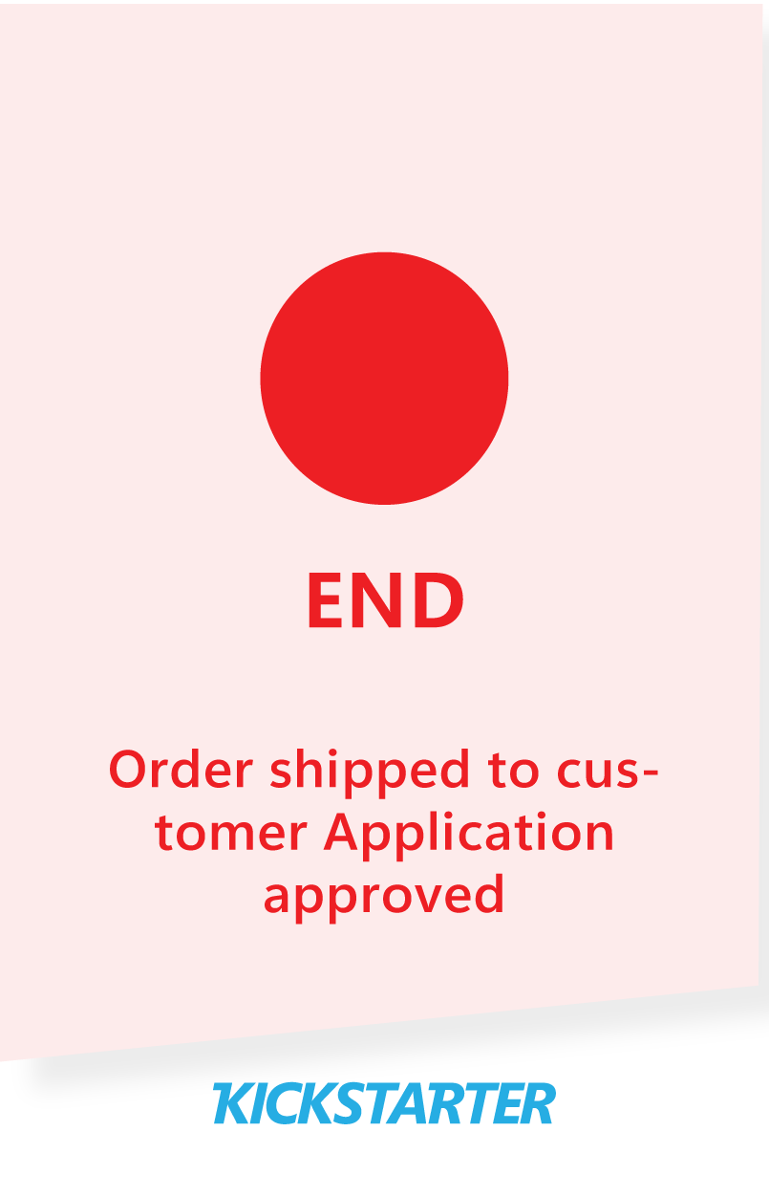
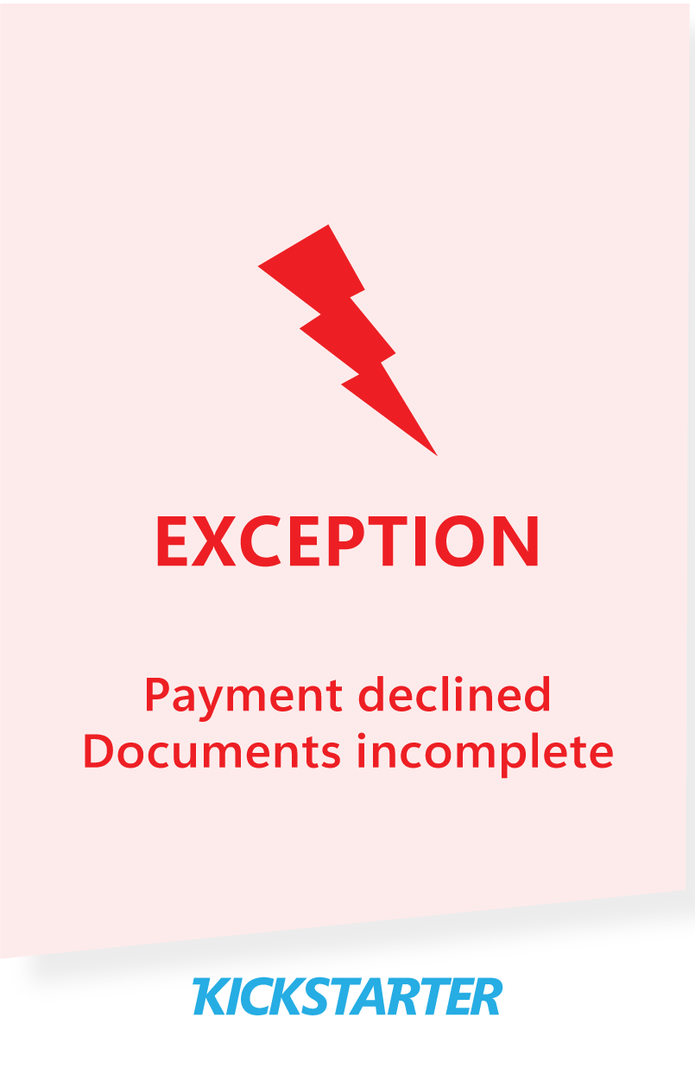
Process mapping cards
These cards represent the core elements of any process, helping teams visualize how work moves, where friction exists, and where change could have the biggest impact.

Slide 15
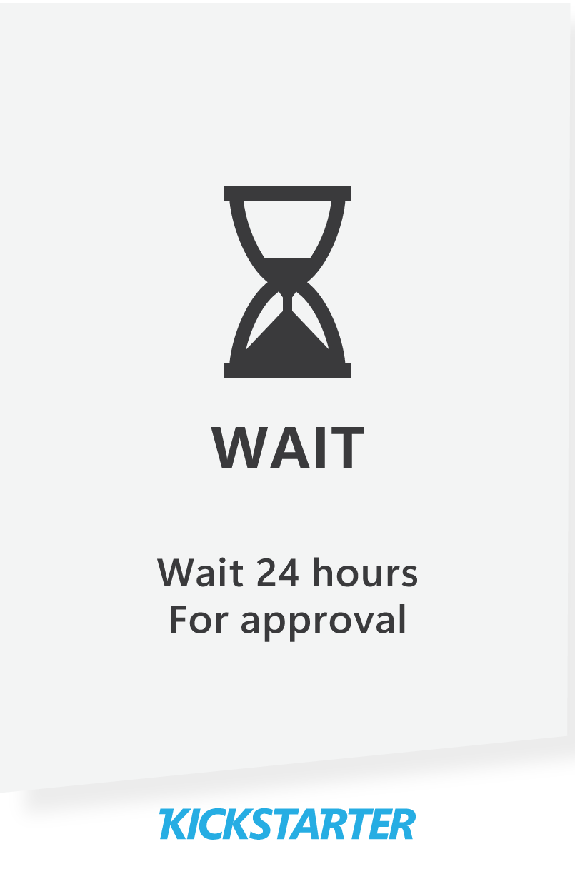

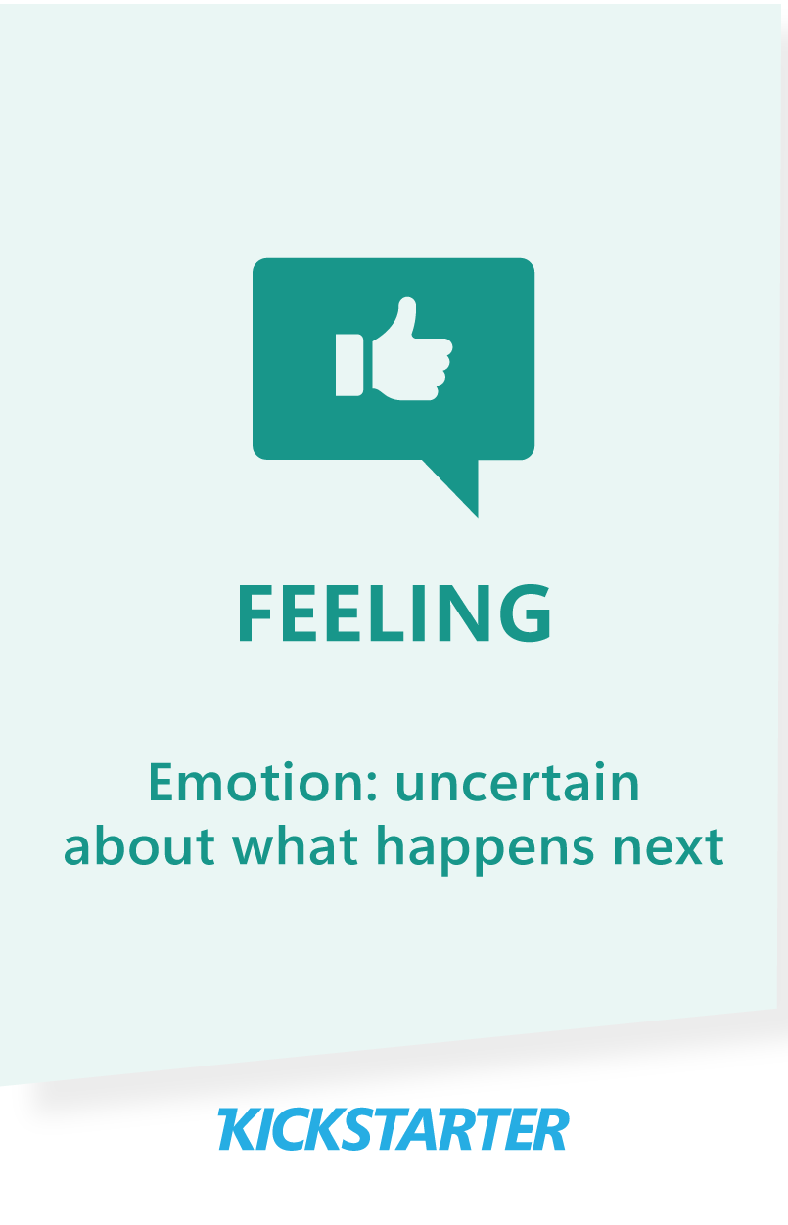
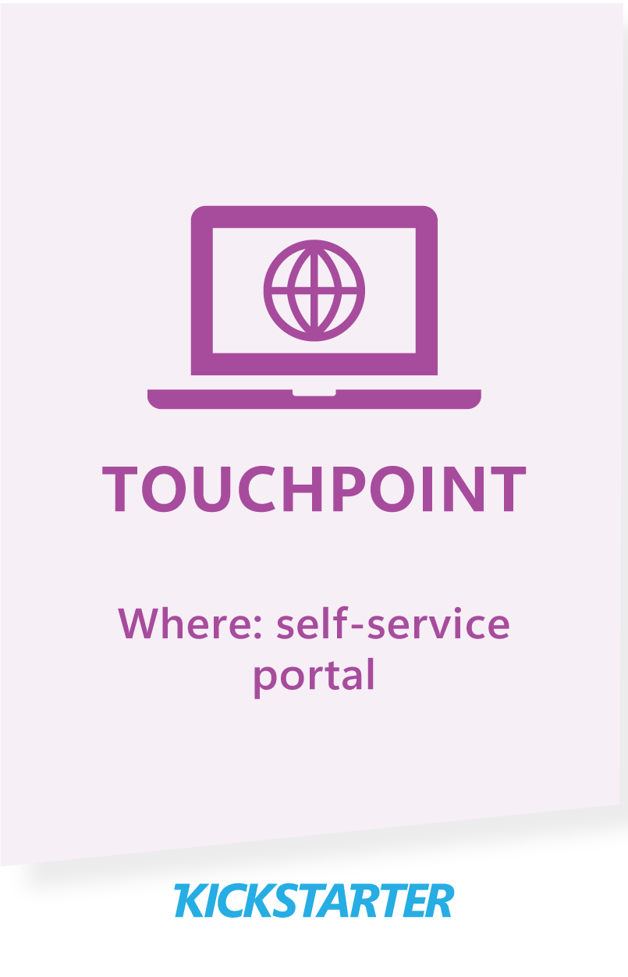
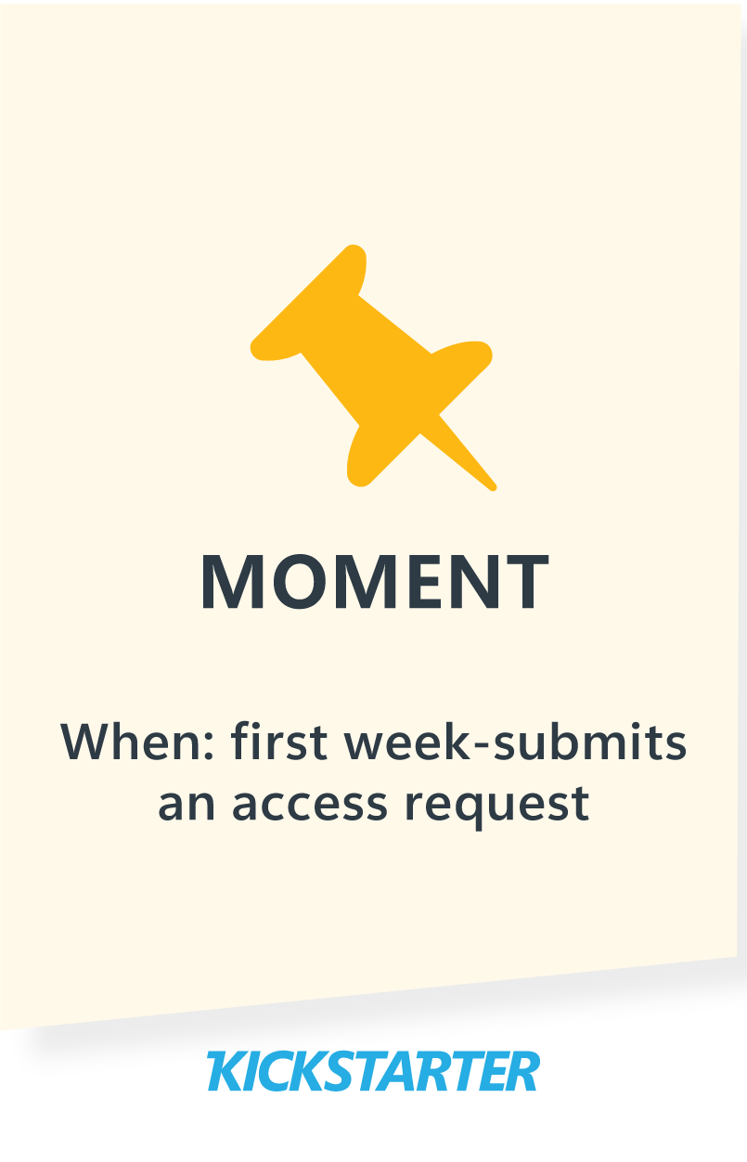
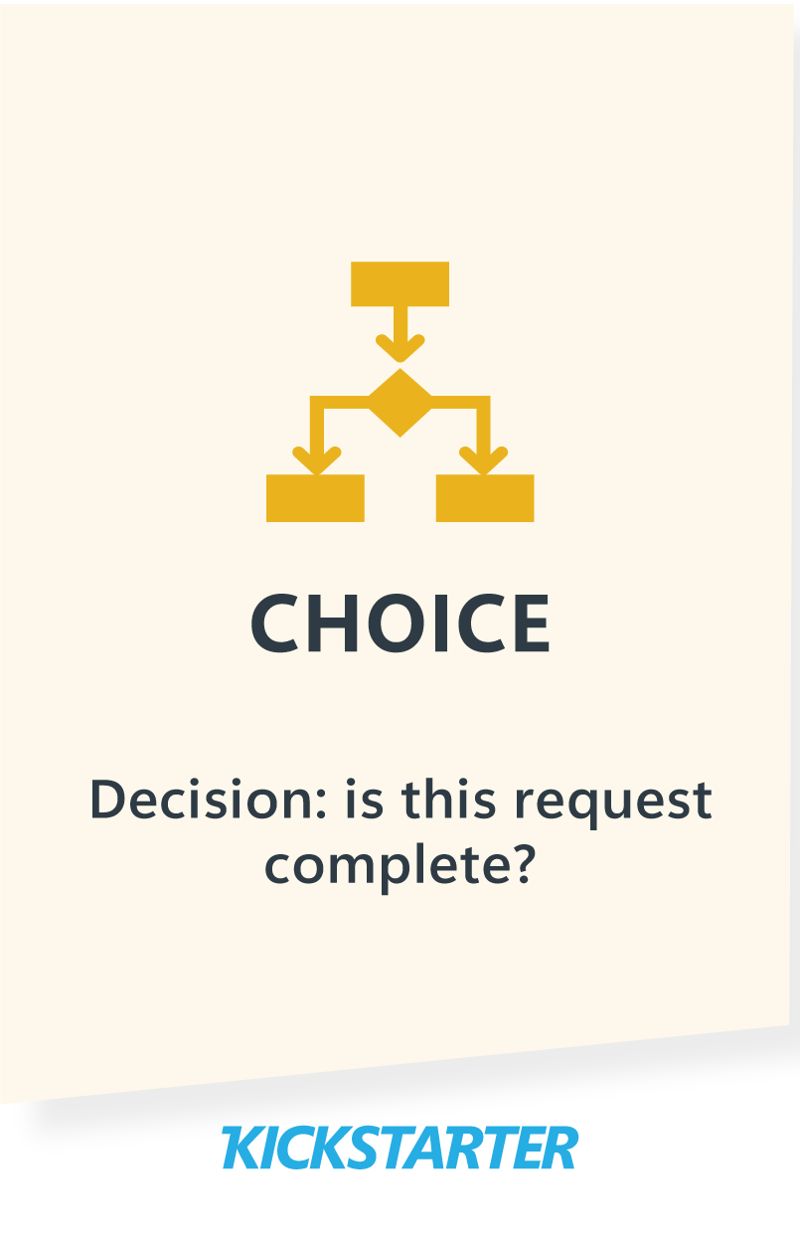
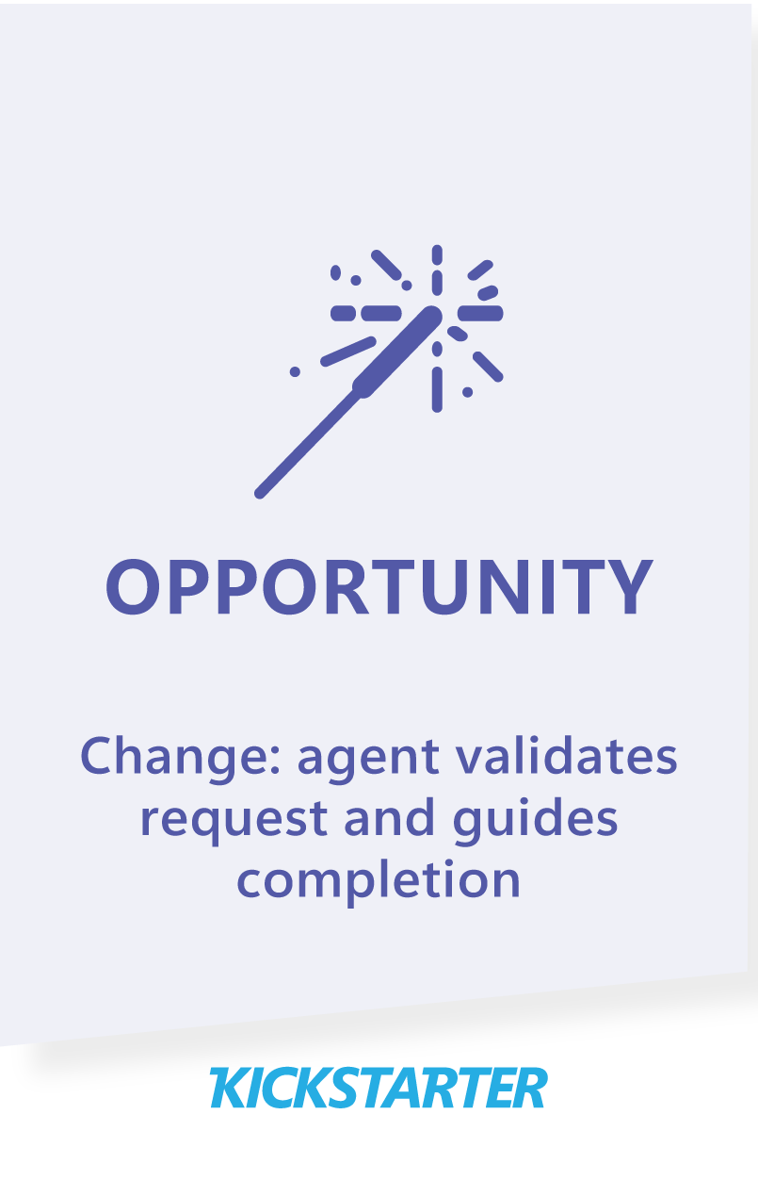
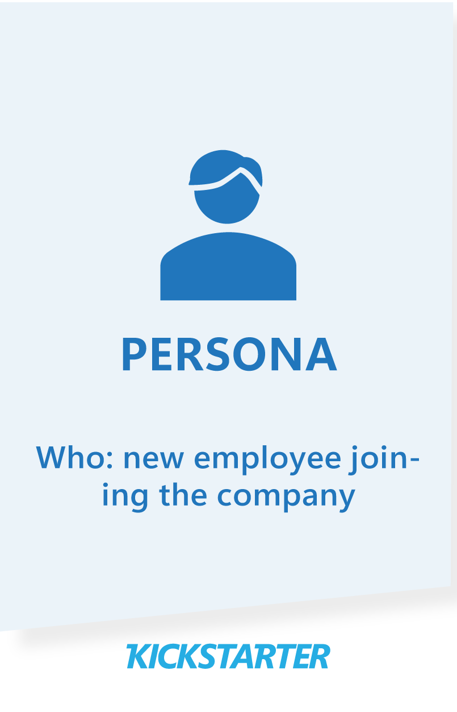
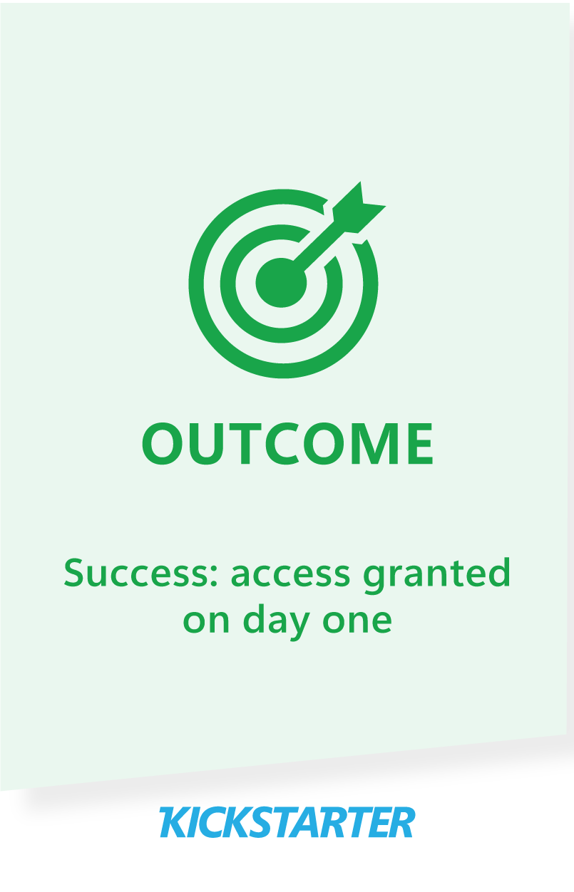
Experience mapping cards
These cards focus on the experience of work, helping teams understand what users encounter, feel, and remember—so improvement isn’t just efficient, but meaningful.

Slide 16
Pain point identification and prioritization

Slide 17
Pain point identification and prioritization
Pain point description | Impact | Frequency | Population | Score
Scoring guidance:
Criterion | 1 (low) | 5 (high)
Impact | Minor inconvenience; minimal effect on outcome | Severe problem; significant impact on customer, employee or organization
Frequency | Rarely occurs | Occurs often, many times per day/ week
Population | Few people affected | Majority of team or multiple customers

Slide 18
If we solved this problem…

Slide 19
If we solved this problem…
Use these starter templates to finish the sentence:
Core format:
“If we eliminated this pain point, then ____ would improve by _____.”
Outcome + metric:
“By solving this problem, we would reduce _____ by _____ and increase _____ by _____”
Person-focused:
“Fixing this issue would help _____ (role/team/customer) to _____ so they can _____.”
Time/ quality focus:
“Resolving this pain would save _____ hours per _____ and improve _____ (speed/quality/accuracy).”
Strategic impact:
“Addressing this pain point will enable us to _____ so that we can achieve _____.”

Slide 20
If we solved this problem…
Optional: consider the value timelines for your sentence
Value timelines
Value
Strategic value
Operational value
Transformational value
Time
If we solved this problem, the value would show up first as ___________, and over time as _______________”

Slide 21

Deepening the view on value
Optional: map the beneficiaries of the solution
Indirect users/ beneficiaries
Direct users/ beneficiaries

Slide 22
Agent design

Slide 23
Agent types
Retriever
Advisor
“Finds and delivers relevant information to support a person’s task or decision.”
“Gives insights, guidance, or recommendations.”
Example: an agent that retrieves HR policies or benefits information.
Example: an agent suggests next-best actions based on data
Collaborator
Assistant
“Works with people or systems to get things done.”
“Helps a person complete a task or make a decision.”
Example: an agent that collects info from a user, then escalates to a manager.
Example: an agent helps submit a helpdesk ticket.
Orchestrator
Performer
“Coordinates a series of steps across systems or teams.”
“Takes direct action and completes tasks automatically.”
Example: an agent that manages onboarding across departments.
Example: an agent that updates a record when conditions are met.

Slide 24
Agent types
Retriever
“Finds and delivers relevant information to support a person’s task or decision.”
Agent types describe the role an agent plays, not the technology behind it.
Use them to clarify what the agent is responsible for, how much autonomy it has, and what design, risk and governance considerations apply
Example: an agent that retrieves HR policies or benefits information.
Why teams start here
Low complexity – typically read-only access to curated sources
Low risk – no autonomous action or system changes
Fast time to value – often evolves into more advanced agent types later
Design considerations (at a glance)
Restrict access to authorized, role-appropriate sources
Focus on grounding quality and relevance
Track retrieval accuracy, unanswered questions, and user feedback
Typical value benefits
Reduced time spent searching for information
Most consistent answers across teams
Improved confidence in decisions
A retriever agent finds and delivers the right information at the. Right time, grounded in approved sources, to support a person’s task or decision.
Common use cases
Employee self-service
Retrieve HR policies, benefits details
IT & operations support
Surface runbooks, troubleshooting steps
Finance & procurement
Retrieve approval rules, spending thresholds
Legal & compliance
Provide access to standard clauses, regulatory guidance
Sales & account teams

Slide 25
Agent types
Advisor
“Gives insights, guidance, or recommendations.”
Agent types describe the role an agent plays, not the technology behind it.
Use them to clarify what the agent is responsible for, how much autonomy it has, and what design, risk and governance considerations apply
Example: an agent suggests next-best actions based on data
Why teams start here
Improve decision quality without removing human judgement
Makes complex information usable at the moment it’s needed
Increases consistency in how decisions are informed
Reduces cognitive load for knowledge-intensive roles
Design considerations (at a glance)
Ensure explainability; show rationale
Address fairness, bias and privacy
Evaluate based on outcomes
Capture user feedback
Typical value benefits
Faster, more confident decisions
Reduced risk and fewer errors
More consistent outcomes
Better use of available data
An advisor agent provides insights, guidance, or recommendations to support human decision-making, without taking action on behalf of the user.
Common use cases
Risk and compliance support
Flag potential issues, policy deviations, or risk indicators
Operational decision support
Recommend next-best actions based on current context
Planning and forecasting
Provide scenario comparisons and impact analysis
Performance insights
Surface trends, anomalies or optimization opportunities
Customer or employee guidance
Suggest responses, resolutions, or prioritization options

Slide 26
Agent types
Collaborator
“Works with people or systems to get things done.”
Agent types describe the role an agent plays, not the technology behind it.
Use them to clarify what the agent is responsible for, how much autonomy it has, and what design, risk and governance considerations apply
Example: an agent that collects info from a user, then escalates to a manager.
Why teams start here
Balances automation and control – progress without losing oversight
Reduces coordination overhead across teams
Improves throughput by handling preparation and routing work
Fits well with human-in-the-loop models
Design considerations (at a glance)
Maintain conversation or flow context across interaction
Provide clear handoff and escalation paths
Design responses to be clear, professional and inclusive
Respect role-based access and org boundaries
Typical value benefits
Faster request handling, fewer errors, less manual coordination
A collaborator agent works with people and systems to move work forward, gathering information, coordinating steps, and escalating when human input or approval is required.
Common use cases
Approval workflows
Collecting required information, validate completeness, routing requests
Case or ticket management
Gather context from users, enrich requests and escalate to correct team
Onboarding coordination
Working across departments and managers to ensure required steps are completed
Cross team requests
Acting as a coordination layer between teams and departments with different tools and processes

Slide 27
Agent types
Assistant
“Helps a person complete a task or make a decision.”
Agent types describe the role an agent plays, not the technology behind it.
Use them to clarify what the agent is responsible for, how much autonomy it has, and what design, risk and governance considerations apply
Example: an agent helps submit a helpdesk ticket.
Why teams start here
Improves productivity without removing human control
Reduces errors and rework through guided execution
Lowers the learning curve for complex or infrequent tasks
Fits naturally into existing workflows
Design considerations (at a glance)
Keep the human clearly in control of decisions and actions
Make guidance context-aware and step-based
Be explicit about what the agent can and cannot do
Design interactions to be clear
Typical value benefits
Faster task completion, more consistent outcomes, improved satisfaction
An assistant agent helps a person complete a task or make a decision, providing guidance, suggestions, and support directly in the flow of work.
Common use cases
Task completion
Helps users submit requests, fill out forms, or complete standard workflows
Decision support
Provide context, options, and recommendations to help users decide what to do next
Employee support
Assist with onboarding tasks, benefits selection or policy-drive processes
IT or service desk support
Guide users through troubleshooting steps or ticket submission

Slide 28
Agent types
Orchestrator
“Coordinates a series of steps across systems or teams.”
Agent types describe the role an agent plays, not the technology behind it.
Use them to clarify what the agent is responsible for, how much autonomy it has, and what design, risk and governance considerations apply
Example: an agent that manages onboarding across departments.
Why teams start here
Reduces manual coordination across teams and systems
Improves reliability of complex, multi-step processes
Makes dependencies explicit and repeatable
Scales execution without scaling management overhead
Design considerations (at a glance)
Use deterministic workflows to constrain behavior
Embed approval checkpoints for high-risk steps
Design for robust error-handling and retries
Ensure end-to-end observability
Typical value benefits
Shorter cycle times, fewer errors and missed steps
An orchestrator agent coordinates a sequence of steps across systems or teams, ensuring work progresses in the right order, with the right checks and handoffs.
Common use cases
Employee onboarding
Coordinates HR, IT, facilities, and manager tasks across systems
Provisioning and access management
Sequence to identity, device and application access steps
Procure-to-pay or quote-to-cash
Orchestrate approvals, validations, and system updates.
Incident or change management
Manage structured response steps across teams and tools
Customer lifecycle workflows
Coordinate onboarding, service activation, or offboarding.

Slide 29
Agent type – human/ agent split
Agent types differ in how work is shared between people and AI.
These examples show that agents are designed to support, coordinate, and assist – not replace human judgement or accountability
Retriever
Collaborator
Orchestrator
Advisor
Assistant
Performer

Slide 30
General foundations for all agent types
Regardless of agent type, certain foundations apply to every AI agent.
These principles ensure agents are intentional, governable, and safe to operate at scale.
Standardize instructions and outputs
Segment knowledge and tools
Instrument and evaluate continuously
Treat prompts and instructions as version-controlled configuration; define identity, tone, scope, mandates and citation rules.
Give each agent access only to the data it needs; restrict retrieval to governed sources and enforce proper filtering.
Collect metrics like latency, cost, error rates, user feedback and accuracy
Choose orchestration pattern
Plan for adoption and change
Define a charter
Create a governance artefact that spells out what the agent will, and won’t do, how it maps to business objectives and which actions are prohibited
Design how people will discover, learn, trust, and work alongside the agent; clarify ownership, escalation paths, and how behavior changes over time
Decide if the agent will run as a deterministic chain (fixed sequence of events), a single agent with dynamic tool-calling or a multi-agent system.

Slide 31
Agent design canvas
Purpose & role | Why does this agent exist? What problem is it solving?
Inputs & data | What triggers it? What data sources and systems does it need to access?
Actions & outputs | What does it actually do? What does success look like?
Human / agent division of labor | What remains the human’s responsibility? How does the human override or approve the agent?
Responsible AI & safety | Any biases to watch for? Sensitive data? Transparency requirements? Approval points?
Evaluation & telemetry | How will you measure performance (accuracy, time, adoption)? What telemetry will you collect to improve it?
Integration & dependencies | Which systems must it connect to? Are there API or authentication considerations?

Slide 32
Agent complexity scoring matrix
Scoring guidance – complexity of solution:
Criterion | 1 (low) | 2 (medium) | 3 (high)
Systems & integration footprint | Read-only data, limited systems, simple APIs | Multiple systems, internal APIs, some orchestration | Core systems (e.g. SAP), legacy platforms, complex auth, transactions
Human-agent autonomy & oversight | Advisory, assistive, human makes final decision | Recommendations with approval gates | Agent acts on behalf of people or makes binding decisions
Data access & sensitivity | Public or non-sensitive internal data | Business-confidential or role-restricted data | Personal, financial, regulated or security sensitive data
Criticality of actions & outputs | Convenience, productivity, minor efficiency gains | Noticeable time savings or quality improvement | Mission-critical process or high-volume operation
Change required to ways of working | Fits naturally into existing workflows | Requires some behavior or process change | Changes roles, responsibilities or trust models
Scoring guidance – value of solution:
Criterion | 1 (low) | 2 (medium) | 3 (high)
Certainty of value | Hypothetical, assumption-heavy, or indirect | Reasonable but dependent on adoption or change | Direct, measurable, and well understood
Magnitude of impact | Marginal improvement | Noticeable improvement across a role or process | Material impact across teams, customers or costs
Breadth of value | Single task or role | Multiple roles or a full process | Enterprise-wide or customer-facing
Time to first value | Months or longer | Several weeks | Immediate or fast

Slide 33
Agent complexity scoring matrix
Complexity score:_____
Value score:_____
10 – 15 high complexity
Complexity
5 – 9 low complexity
4 – 8 low value
8 – 12 high value
Value

Slide 34
What you leave with
What you’ve created today
By the end of this workshop, you’ve done more than brainstorm ideas.
You’ve created a structured, defensible view of work, grounded in reality.
Notes:

Slide 35
Thoughts and ideas
Notes:

Slide 36
Reimagining work isn’t about replacing people with AI.
It’s about removing friction so people can focus on what matters most
This workshop introduced a simple but repeatable way to reimagine work.
You started by choosing a practical entry point – a role, a process, or an experience, and used it to uncover real friction in how work happens today. From there, you translated that insight into a clearly defined opportunity, grounded in people’s needs, business context, and measurable value.
Rather than jumping into technology, you focused first on clarity: what problem is being solved, who it affects, and what success looks like. Only then did you shape an agent concept – defining its roles, boundaries, level of autonomy, and how people remain in control.
This approach isn’t tied to a specific tool or solution. It’s a way of thinking that can be reused wherever work feels inefficient, unclear, or constrained.
Start small. Apply it often. Adapt it to your context.

